Slide 1


Select Homes like Never Before
Presented By,
Himadri Biswas
Navin Kumar Singh
Piyush Dhamdere
Aditya Mehta

Slide 2


Increase in Houses (Supply)
Housing Stock
13.30 million units in 1961 to 78.48 million units in 2011 (URBAN REGION)
- According to 2011 Census of India
Notes:
The 15th Indian Census was conducted in two phases, house listing and population enumeration. House listing phase began on 1 April 2010 and involved collection of information about all buildings

Slide 3
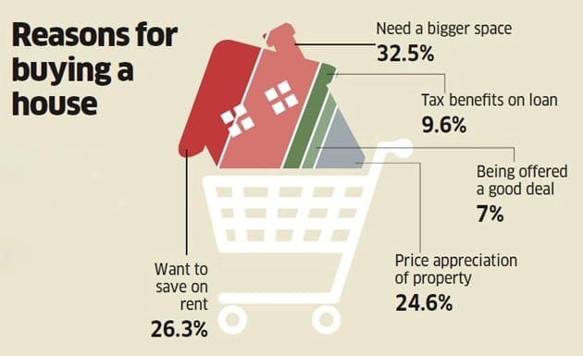
People have Reasons
Most buyers are motivated by the need for more space and savings on rent.

Slide 4

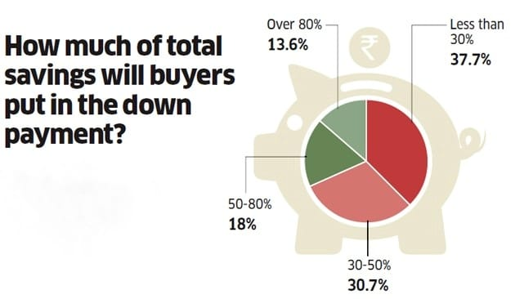
Ready To Spend
One out of two homebuyers is ready to pour more than 50% of his/her total savings into the down payment.

Slide 5
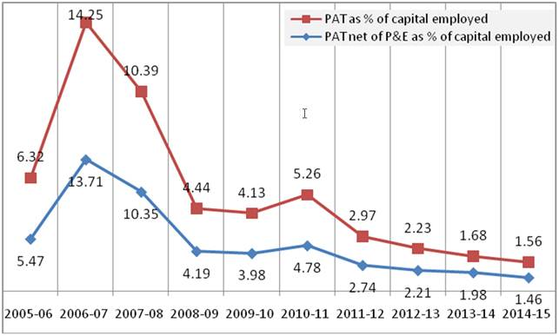
Current Situation
“At the end of 2017, India’s residential sector appears to have shrunk to a fraction of the size it was less than a decade ago,” said Shishir Baijal, chairman of Knight Frank.
New project launches fell 41% and sales of new homes fell 7% in 2017.
There are still hundreds of thousands of unsold properties, and it may take nearly two years to sell off just those, the report says.

Slide 6




Why ?
Accessibility
Lack of Time
Once in a
Lifetime Job
Lack of Targeted
Advertisement

Slide 7

Executive Summary
Mobile App enabling Real Estate Companies to provide users with a more interactive and customizable view of their dream homes.
Enhance the user experience by,
Providing them hands on accessibility
Customizable Designs.
Space Management Idea.
Spontaneous Mortgage rates.
Our aim is to strengthen the backbone on real estate industry by using technology specifically Augmented Reality.

Slide 8
Market Analysis
Target market
Real Estate Companies across the country.
Specific segment are those companies who have more than 50 houses to sell/ rent
Existing players with similar products
Currently, there is no player in this field by our knowledge
Websites like MagicBricks and Square Yards just advertise the property with it’s details and few pictures.
Most of the users still have to visit the site by travelling and have to assume how their furniture will fit or look inside that house.
Our idea is different as we are trying to build an app that will provide a whole new experience of selecting homes by augmentation and customizing techniques to the present architecture.

Slide 9

Product Service
Notes:
Accounts: It will store the daily transactions and at the end of the year will provide the owner with the balance sheet and P&L account along with filling the monthly returns for him.
Finance: It will keep the record of company’s profit throughout the year along with helping him/her in investing for fulfilling short term and long term goals. It will prepare the cash budget of the company from which the owner can look into the cash flow through the business.
Inventory: It will keep the record of all the products available in the shop and will be updated with every transaction. It will look into the sales of previous years or related companies in order to assist the owner in the management of inventory.
Connections: It will connect the shops and wholesalers of nearby area so that they can connect better and deal through our app. The inventory part can automatically generate an order in case of need of a product to the wholesaler from which is purchased regularly.

Slide 10

Existing Competitors
There are Websites like MagicBricks and Square Yards that just advertise the property with it’s details and few pictures.
Our competitors want to convert real estate business into something like e-commerce but we want them to provide user with the techniques by which he can decide whether the particular house can become his dream home or not.

Slide 11

SWOT Analysis
Strengths:
Easy to understand and use.
Customizable Interior
Saves money and time.
Weaknesses:
Needs good marketing.
Urban Centric App.
Opportunities:
High potential growth.
User acceptability can turn our app into huge market place for real state companies.
Threats:
Brokers can oppose the idea.

Slide 12

Customer Analysis
Our major customers will be Real Estate Companies,
Increasing their flexibility
Customer acquisition
Also our website will involve opportunities for Real-Estate Businesses/ Brokers who are just getting started provided they meet our terms & conditions.

Slide 13
Benefits

Slide 14

Technical Feasibility & Implementation
It is very much feasible with people working in the following domains,
AR Development
Cloud Storage
3D modelling
Implementation will be carried out in Unity3D with the help of SDKs like ARCore & Vuforia.

Slide 15

Cost Estimates
Prototype development will not require any financial help assuming students working on the project will treat it as a learning experience.
Once our service hits the market,
Operating & Maintenance
Cloud services like AWS.
Vuforia Cloud Database
Dedicated servers.
Marketing – 15,00,000 estimated for 6 months.
Personnel – 5,00,000 estimated for 6 months.

Slide 16

Risk Analysis
Cost Estimates
Market
Understand what other competitors are offering and improve ours to gather more users.
Government Rules
Stay updated of the mortgage rates and roll out releases in case of any changes.
Technology
QA testers & developers will have to invest time handling Cloud Database.
Legal
Our product will have to comply with the laws and protect our customers privacy.

Slide 17
Thank You!
Q&A

